Slide 1
Chemoreception
Gustation & Olfaction
I. Gustation
A. Anatomy & Signal Transduction
II. Olfaction
A. Anatomy & Signal Transduction
B. Brain-eating Amoeba
III. Perception of Pheromones

Slide 2
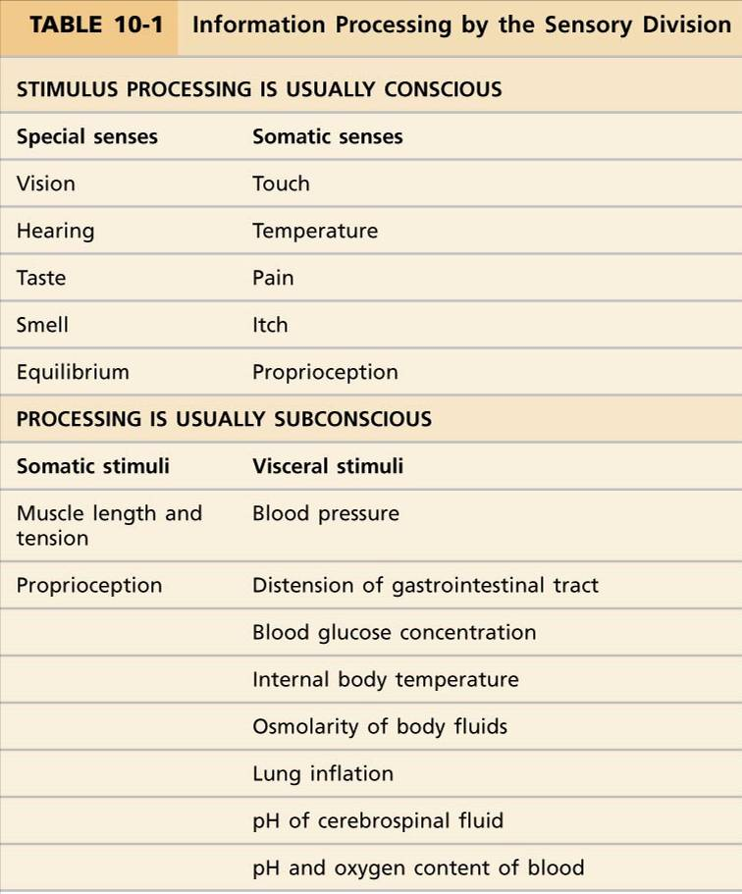

Slide 3
To be detected by chemosensory cells, molecules must:
be water-soluble
bind to a membrane-bound receptor protein
activate the receptor protein
exhibit receptor specificity

Slide 4
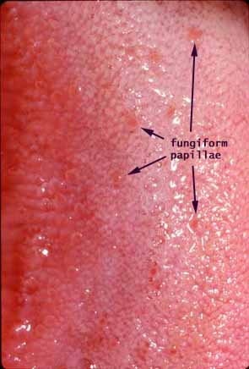
Gustation
Differentiates taste of different substances
Approximately 10,000 taste buds:
-tongue
-palate
-pharynx
Each taste bud contains ~ 100
receptor (“taste”) cells
Taste buds occur in clusters called
fungiform papillae (mostly)
Texture of food is detected by mechanoreceptors on filiform papillae

Slide 5
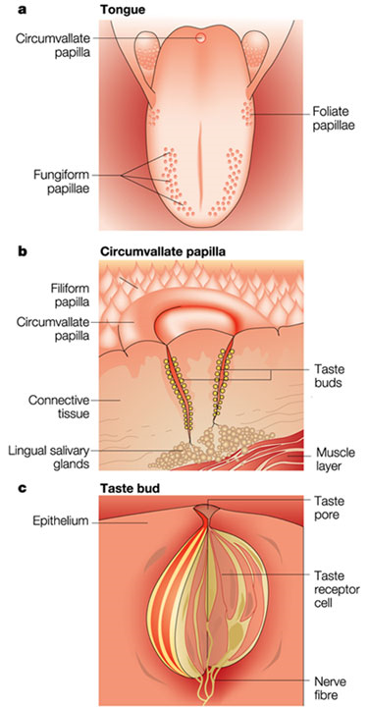
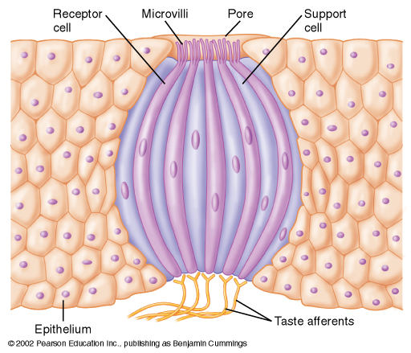

Slide 6
Classes of chemicals activate different receptors
Sugars
  Sucrose, lactose, maltose
  Activate ‘sweet receptors’
Acids
  Low pH
  Activate ‘sour receptors’
Salts
  NaCl, NaI
  Activate salt receptors
Alkaloids
  Caffeine, nicotine, quinine
  Activate ‘bitter receptors’
Glutamate
  Amino acid found in many proteins, MSG
  Activate ‘Umami’ receptors

Slide 7
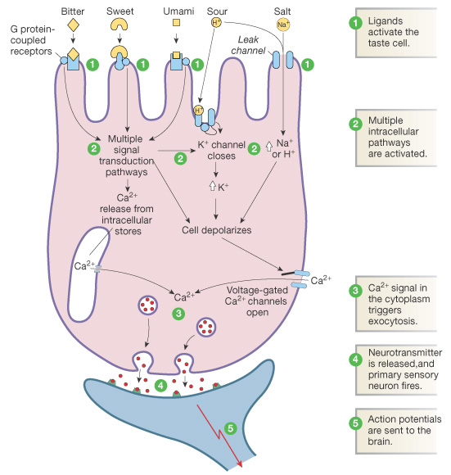

Slide 8
Salt receptor activity
Salt dissolves in saliva, extracellular [Na⁺] increases
Na⁺ influx rate increases through leak channels
Membrane hypopolarizes
Ca²⁺ channels open on plasma membrane and endoplasmic reticulum
Ca²⁺ binds to vesicles → NT exocytosis

Slide 9
Receptor type | Activation
Salty | Na⁺ influx through leak channels
Sour | H⁺ influx through leak channels Close K⁺ leak channels
Sweet | Activate G protein-coupled receptors that in turn activate a 2nd messenger
Bitter
Umami

Slide 10
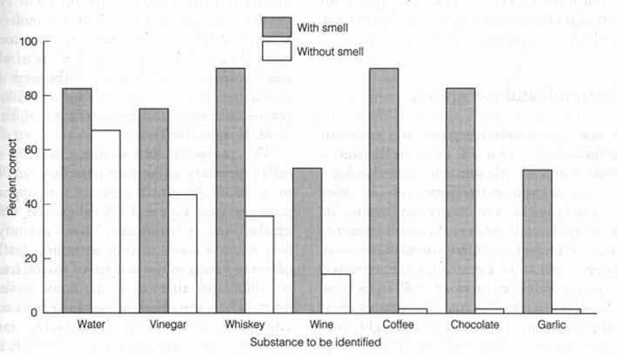
Taste is not strictly an independent sense
Synesthesia: when a stimulus of one type causes an
involuntary perception of another type
Taste is a combination of gustation, olfaction, mechanoreception, and nociception.

Slide 11
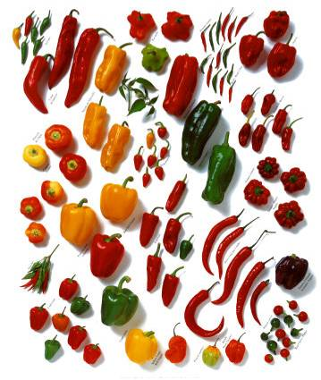
Capsaicin
Toxicity of Capsaicinoids
In order to determine the lethal toxic level of capsaicinoids in animals, and to extrapolate that level for humans, researchers in 1980 performed a rather gruesome experiment with mice, rats, guinea pigs and rabbits. Pure capsaicin was administered intraveinously, subcutaneously, in the stomach, and applied topically until the animals died. …
The author of the study, T. Glinsukon, concluded that the acute toxicity of capsaicinoids as a food additive in mankind was negligible. “If humans are about as sensitive as mice, the acute fatal toxicity dose for a 150 pound person would be about thirteen grams of pure, crystalline capsaicinoids, which frankly, sounds high to us. I think that less than that would be lethal.”

Slide 12
Olfaction
Anatomy & Signal Transduction
Receptor cells found in the olfactory epithelium, within
nasal cavity.
Receptors are afferent neurons
Approximately 10,000,000 olfactory cells
Chemicals detected depend on the receptor type,
of which there are ~1,000
These receptor cells are the only neurons known to
regularly undergo neurogenesis (complete turnover ~every
2 months)

Slide 13
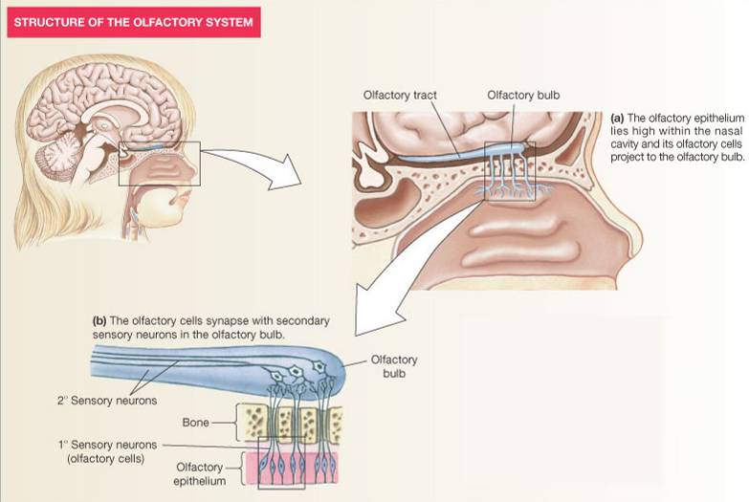

Slide 14
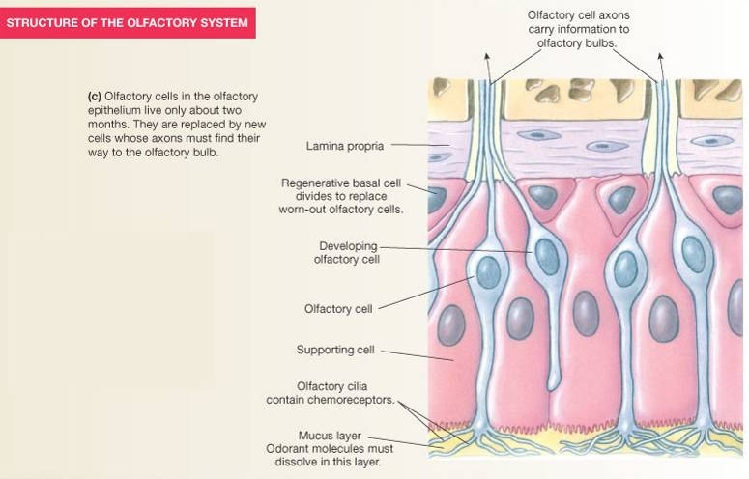
Ethmoid bone

Slide 15
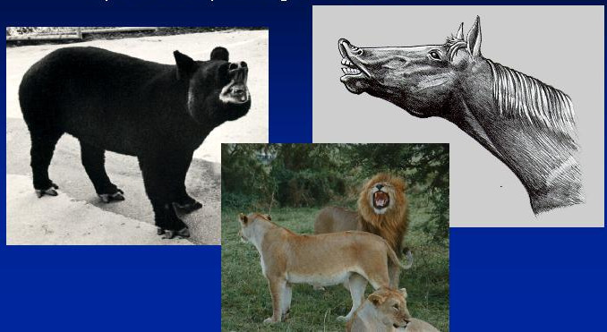
Flehmen – Behavior that enhances detection of reproductive pheromones
Vomeronasal Organ (VNO)
*Accessory olfactory structure in many mammals regressed/absent in humans, but we may still detect pheromones

